Slide 1
Topic: Graphing EQ: When do I use Line Graphs?
Mrs Parlevliet
Year 11 Essentials

Slide 2
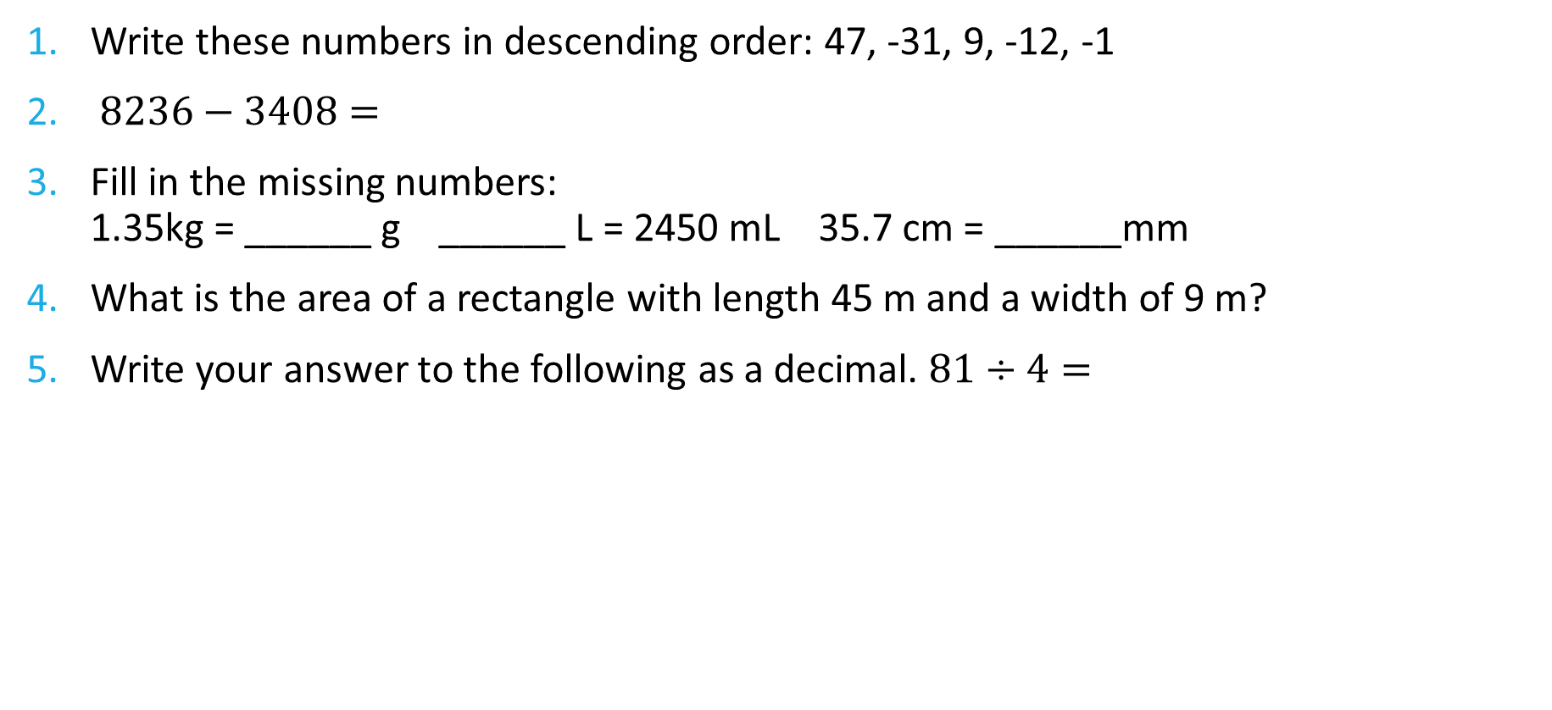
FiVe Questions
Topic: Graphing
Date: XX/XX/2021
EQ – When do I use a line graph?
Write these numbers in descending order: 47, -31, 9, -12, -1
$8236−3408=$
Fill in the missing numbers: 1.35kg = ______ g ______ L = 2450 mL 35.7 cm = ______mm
What is the area of a rectangle with length 45 m and a width of 9 m?
Write your answer to the following as a decimal. $81÷4=$

Slide 3
24
7
30
Topic: Graphing
Date: XX/XX/2021
EQ – What do I use line graphs?
Line graphs are used to show trends in continuous data. Continuous data is data that can be measured.
Examples include: Time, height, weight, length, wind speed, temperature, voltage
When line graphs are used correctly they generally show smooth curves or a straight line. If a line graph appears jagged, you need to check whether the line graph is appropriate to use.
What are line graphs?
WICOR
Notes:
Check for understanding!
What is numerical data?
What is categorical data?
What is discrete data?
What makes data continuous?

Slide 4
Text, p. 86
Perth Temperature and Rainfall data, (1994-2020)
 | Jan | Feb | Mar | Apr | May | Jun | Jul | Aug | Sep | Oct | Nov | Dec
Mean Maximum Temp (˚C) | 31.2 | 31.6 | 29.6 | 25.9 | 22.3 | 19.5 | 18.4 | 19.1 | 20.4 | 23.4 | 26.8 | 29.3
Mean Minimum Temp (˚C) | 18.1 | 18.4 | 16.8 | 13.8 | 10.4 | 8.6 | 7.9 | 8.3 | 9.5 | 11.6 | 14.4 | 16.4
Mean rainfall (mm) | 19.1 | 13.4 | 19.7 | 35.2 | 87.7 | 127.3 | 144.5 | 125.5 | 82.8 | 38.8 | 21.7 | 10.6

Slide 5
Text, p. 86

Slide 6
Task
Complete Questions 1 -4 on page 87 of your text.

